Slide 1
Android Programming :Event Handling
Prof. Seongwook Youn
Department of Software
Korea National University of Transportation

Slide 2
Custom Component
Android offers a sophisticated and powerful componentized model for building your UI, based on the fundamental layout classes: View and ViewGroup. To start with, the platform includes a variety of prebuilt View and ViewGroup subclasses — called widgets and layouts, respectively — that you can use to construct your UI
Basic approach
Extend an existing View class or subclass with your own class
Override some of the methods from the superclass. The superclass methods to override start with 'on', for example, onDraw(), onMeasure(), and onKeyDown()
Use your new extension class. Once completed, your new extension class can be used in place of the view upon which it was based

Slide 3
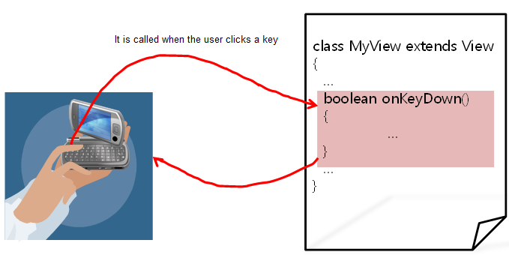
Overriding of Event Handling Method

Slide 4
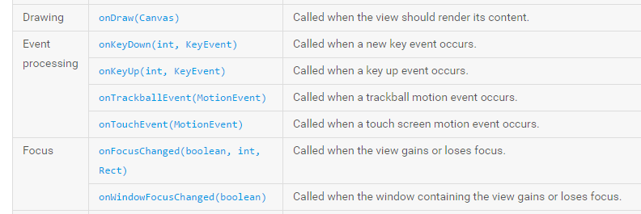
Overridable Callback Methods
Notes:
커스텀 컴포넌트 생성 방법 – View 클래스를 상속받아 자식 클래스 생성, 그 다음 부모 클래스를 재정의 (주로 앞에 on이 붙은 것들), 사용

Slide 5
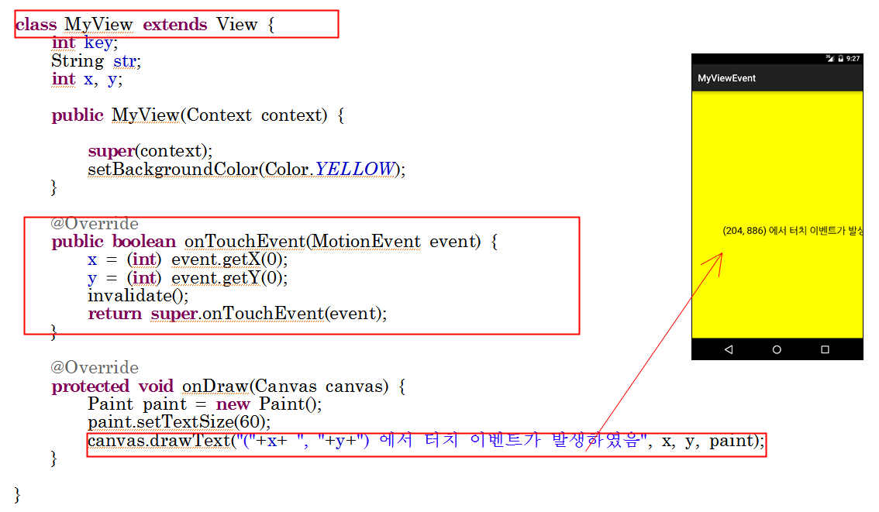
Example
MyView inherits superclass View and overrides two methods (onTouchEvent and OnDraw)
Many info are transferred
Through event
Notes:
View 클래스를 상속받아서 MyView 클래스 정의. 두개의 메소드 재정의 – onTouchEvent – 터치 이벤트 발생하면 이벤트 처리, onDraw- 화면에 글자를 그리기위함

Slide 6
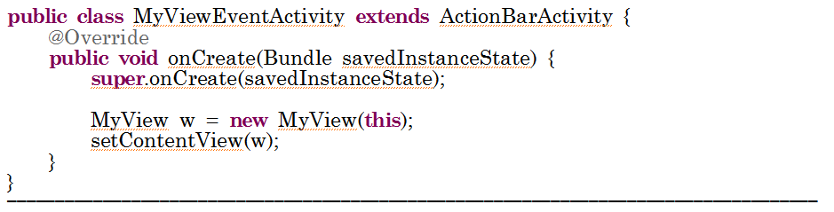
Example
Notes:
MyViewEvent 실행

Slide 7
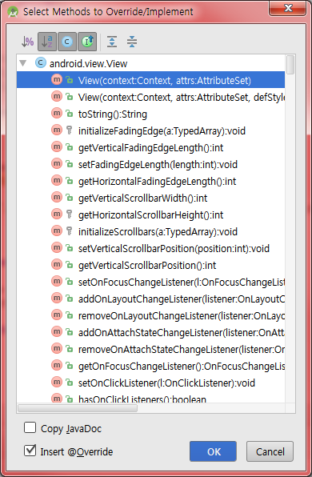
Useful tip for Callback Method Overriding
[Code]->[Override Methods...]

Slide 8
Touch Event
First, define custom view, then override onTouchEvent()
class MyView extends View { ...
@Override
public boolean onTouchEvent(MotionEvent event) {
x = (int) event.getX();
y = (int) event.getY();
...
}
}

Slide 9

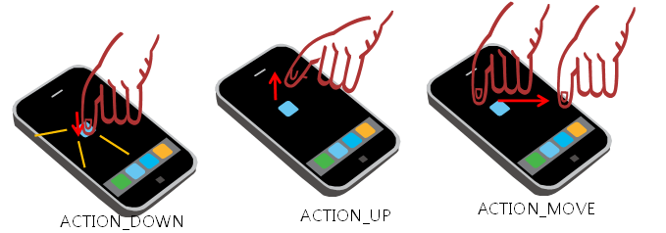
Touch Event

Slide 10
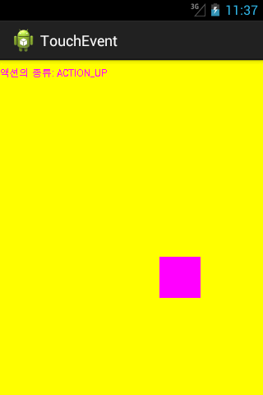
Move Rectangle by Touch

Slide 11
Touch Event Example
public class TouchEventActivity extends Activity {
protected class MyView extends View {
int x = 100, y = 100;
String str;
public MyView(Context context) {
super(context);
setBackgroundColor(Color.YELLOW);
}
@Override
protected void onDraw(Canvas canvas) {
Paint paint = new Paint();
paint.setColor(Color.MAGENTA);
canvas.drawRect(x, y, x + 50, y + 50, paint);
canvas.drawText("액션의 종류: " + str, 0, 20, paint);
}

Slide 12
Touch Event Example
@Override
public boolean onTouchEvent(MotionEvent event) {
x = (int) event.getX();
y = (int) event.getY();
if (event.getAction() == MotionEvent.ACTION_DOWN)
str = "ACTION_DOWN";
if (event.getAction() == MotionEvent.ACTION_MOVE)
str = "ACTION_MOVE";
if (event.getAction() == MotionEvent.ACTION_UP)
str = "ACTION_UP";
invalidate();
return true;
}
}
@Override
public void onCreate(Bundle savedInstanceState) {
super.onCreate(savedInstanceState);
MyView w = new MyView(this);
setContentView(w);
}
}

Slide 13
Output

Slide 14
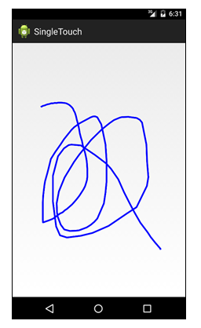
Drawing by touch

Slide 15
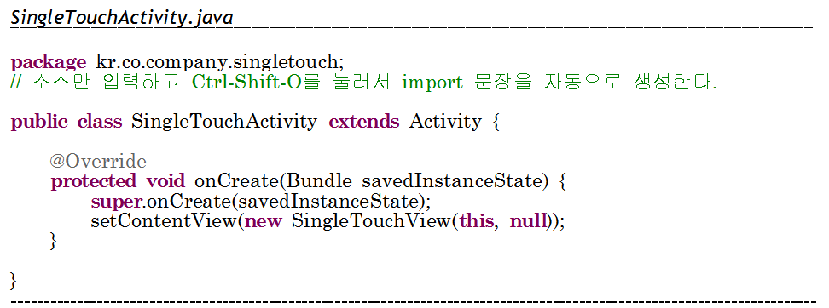
Drawing by touch #1

Slide 16
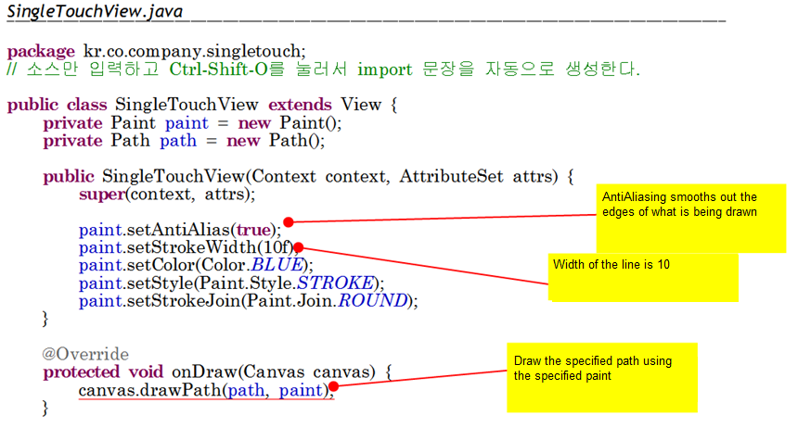
Drawing by touch #2

Slide 17
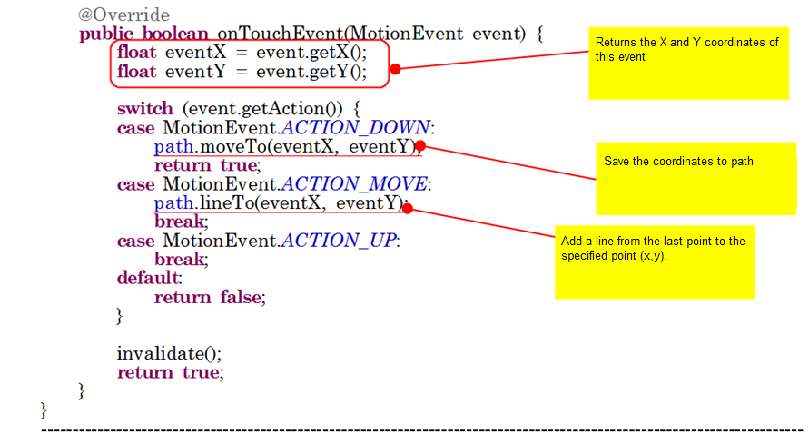
Drawing by touch #3

Slide 18
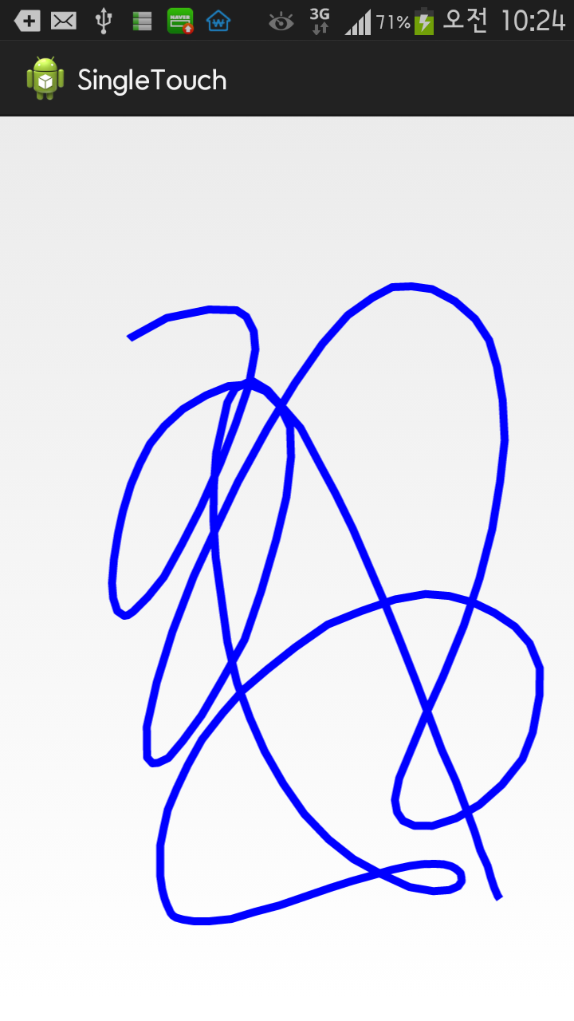
Output
Notes:
SingleTouch 실행

Slide 19
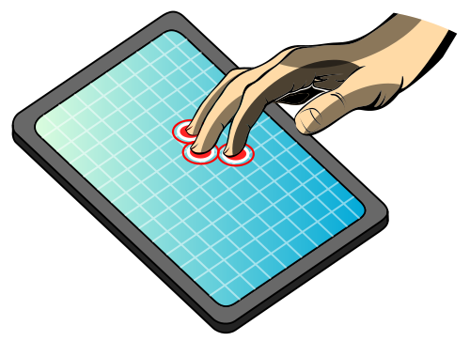
Multi-touch
A multi-touch gesture is when multiple pointers (fingers) touch the screen at the same time
Usually, it is used for extension or contraction of image

Slide 20


Touch Event

Slide 21
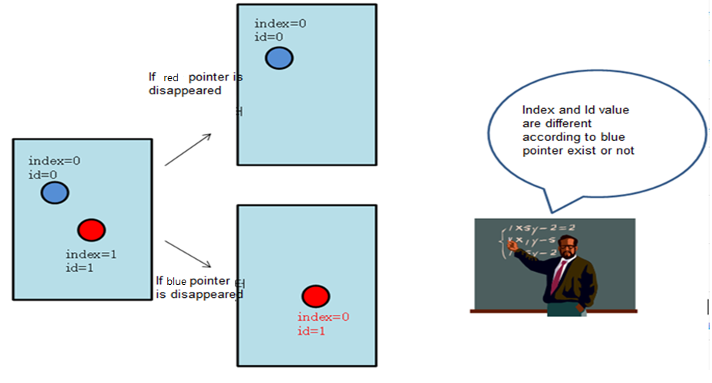
Index and Id
First touch is always index 0, so second touch is index 1, etc.
Index: A MotionEvent effectively stores information about each pointer in an array. The index of a pointer is its position within this array. Most of the MotionEvent methods you use to interact with pointers take the pointer index as a parameter, not the pointer ID.
ID: Each pointer also has an ID mapping that stays persistent across touch events to allow tracking an individual pointer across the entire gesture
Notes:
First touch is always index 0, so second touch is index 1, etc.

Slide 22
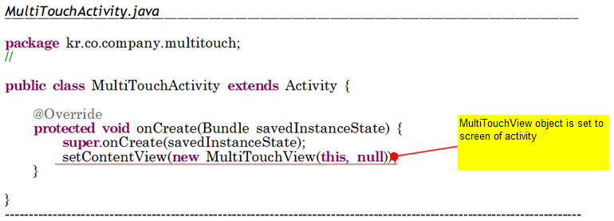
Drawing Circles by Touch

Slide 23
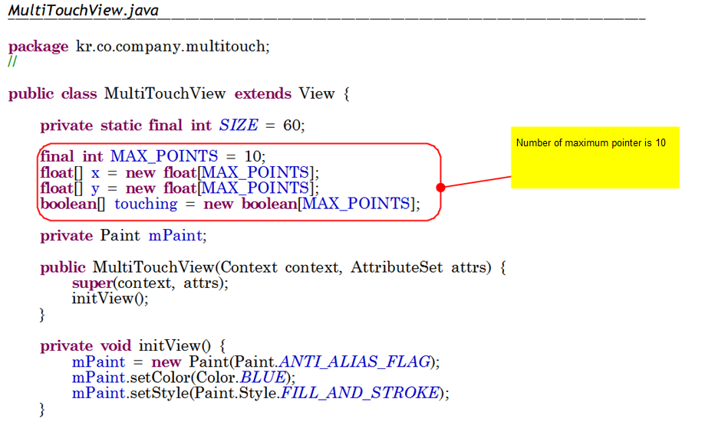

Slide 24
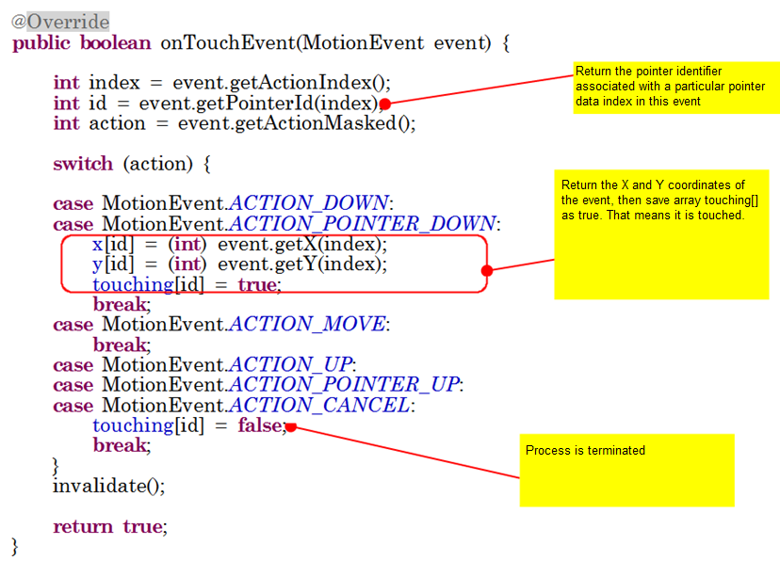

Slide 25
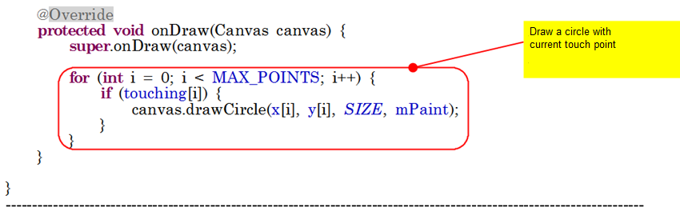
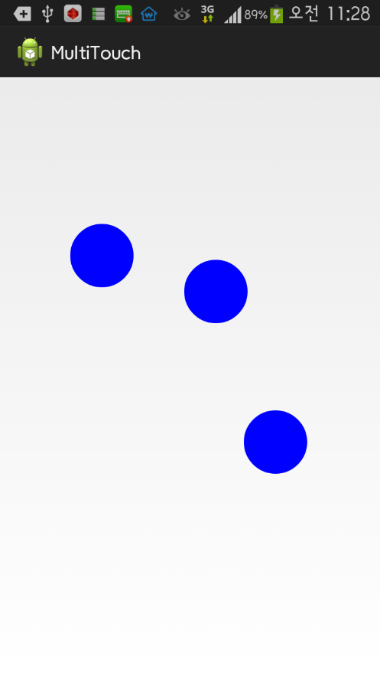
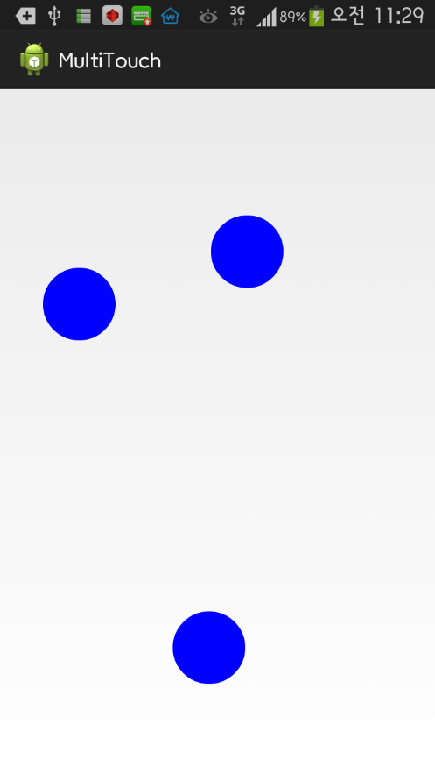
Notes:
MultiTouch 실행

Slide 26
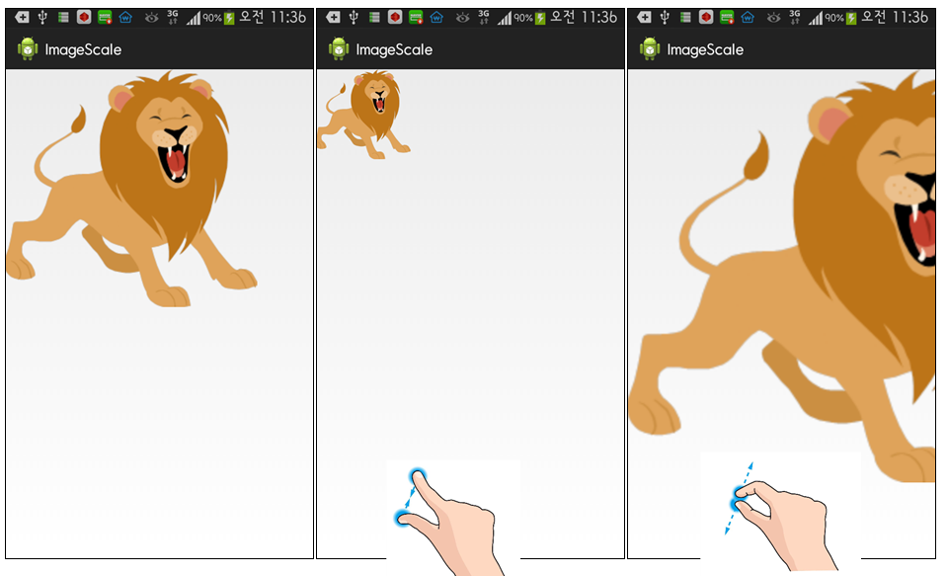
Pinch Zoom

Slide 27
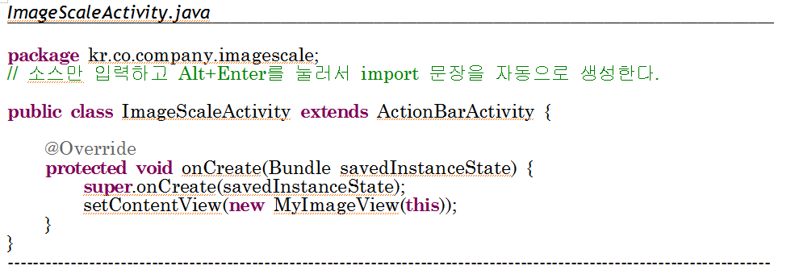
Define Activity

Slide 28
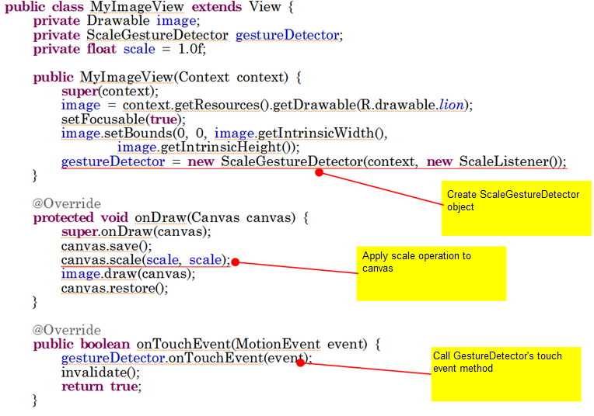
Define View
Set initial image size

Slide 29
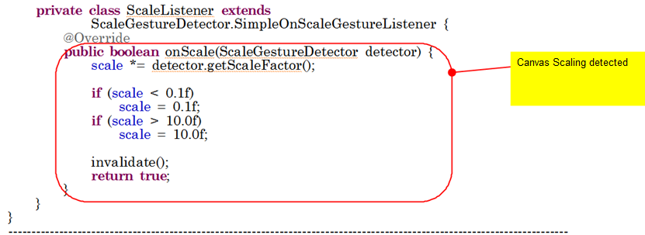
Define View
Notes:
ImageScale 실행

Slide 30
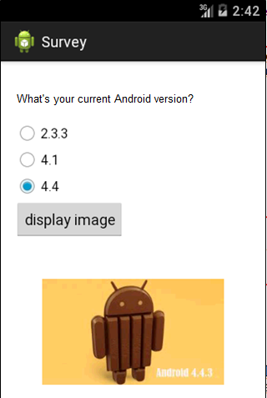
Lab: Survey App
Notes:
Survey 실행

Slide 31
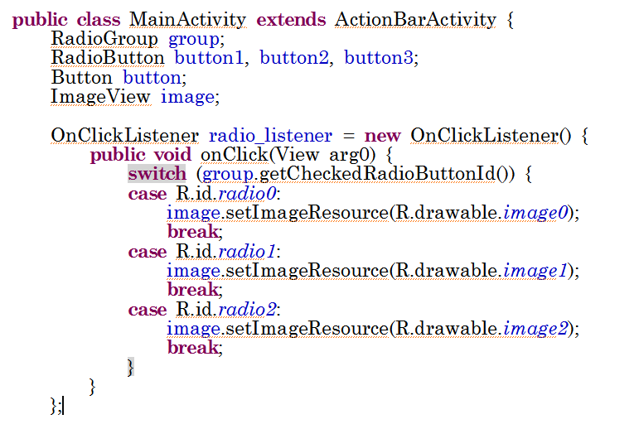
Event Handling

Slide 32
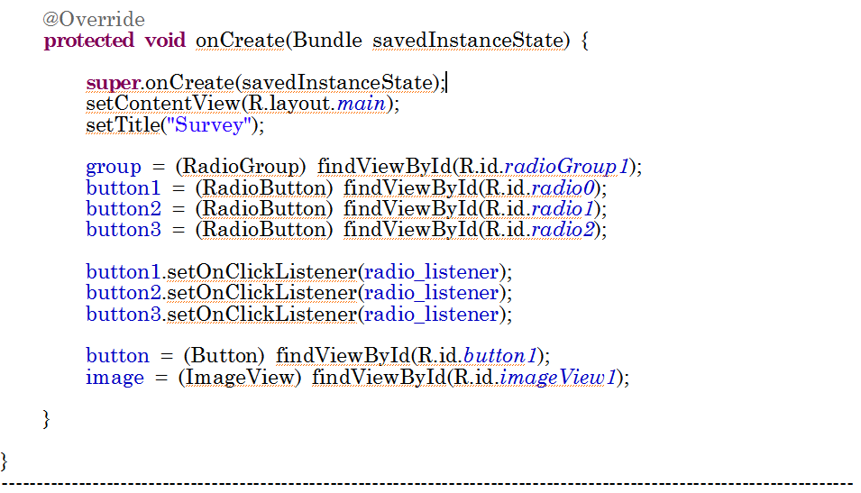
Event Handling

Slide 33
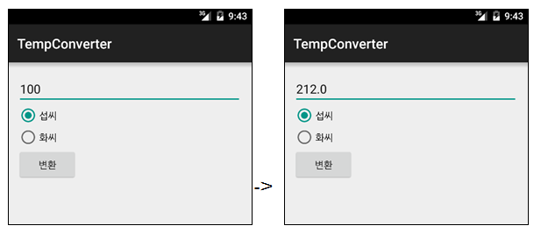
Lab: Temperature Converter App
섭씨 (Celcius) ⬅➔ 화씨 (Fahrenheit)

Slide 34
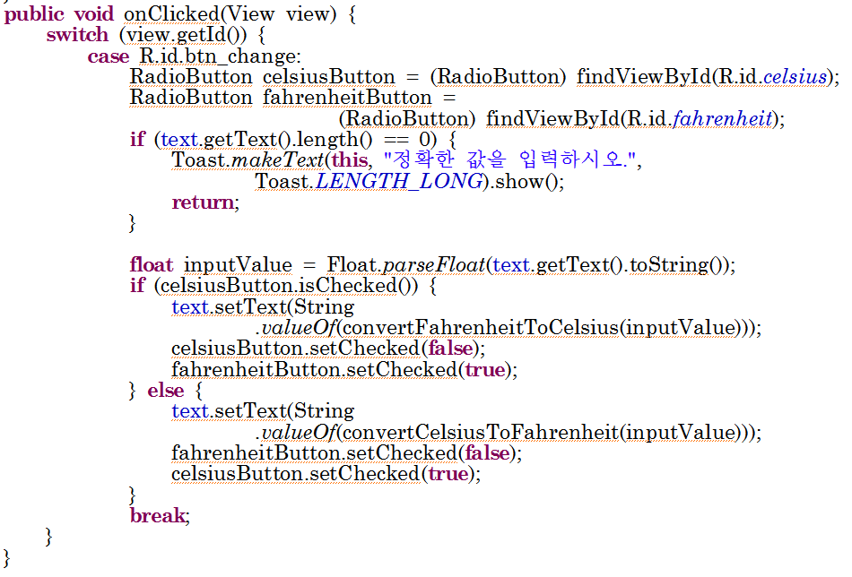
Code
Notes:
TempConverter 실행

